Slide 1
Logistics Tracking Application
By: James Humphries, Keith Maina, and
Onwuegbuchulem Chimezie

Slide 2
Introduction
Logistics is a crucial aspect of the modern global economy.
There is a need to adopt cutting-edge technology solution to enhance tracking and visibility while maintaining security and transparency
Blockchain technology has the potential to revolutionize the logistics industry by providing a secure, transparent, and immutable way to track goods and ensure accountability at every stage of the supply chain.

Slide 3
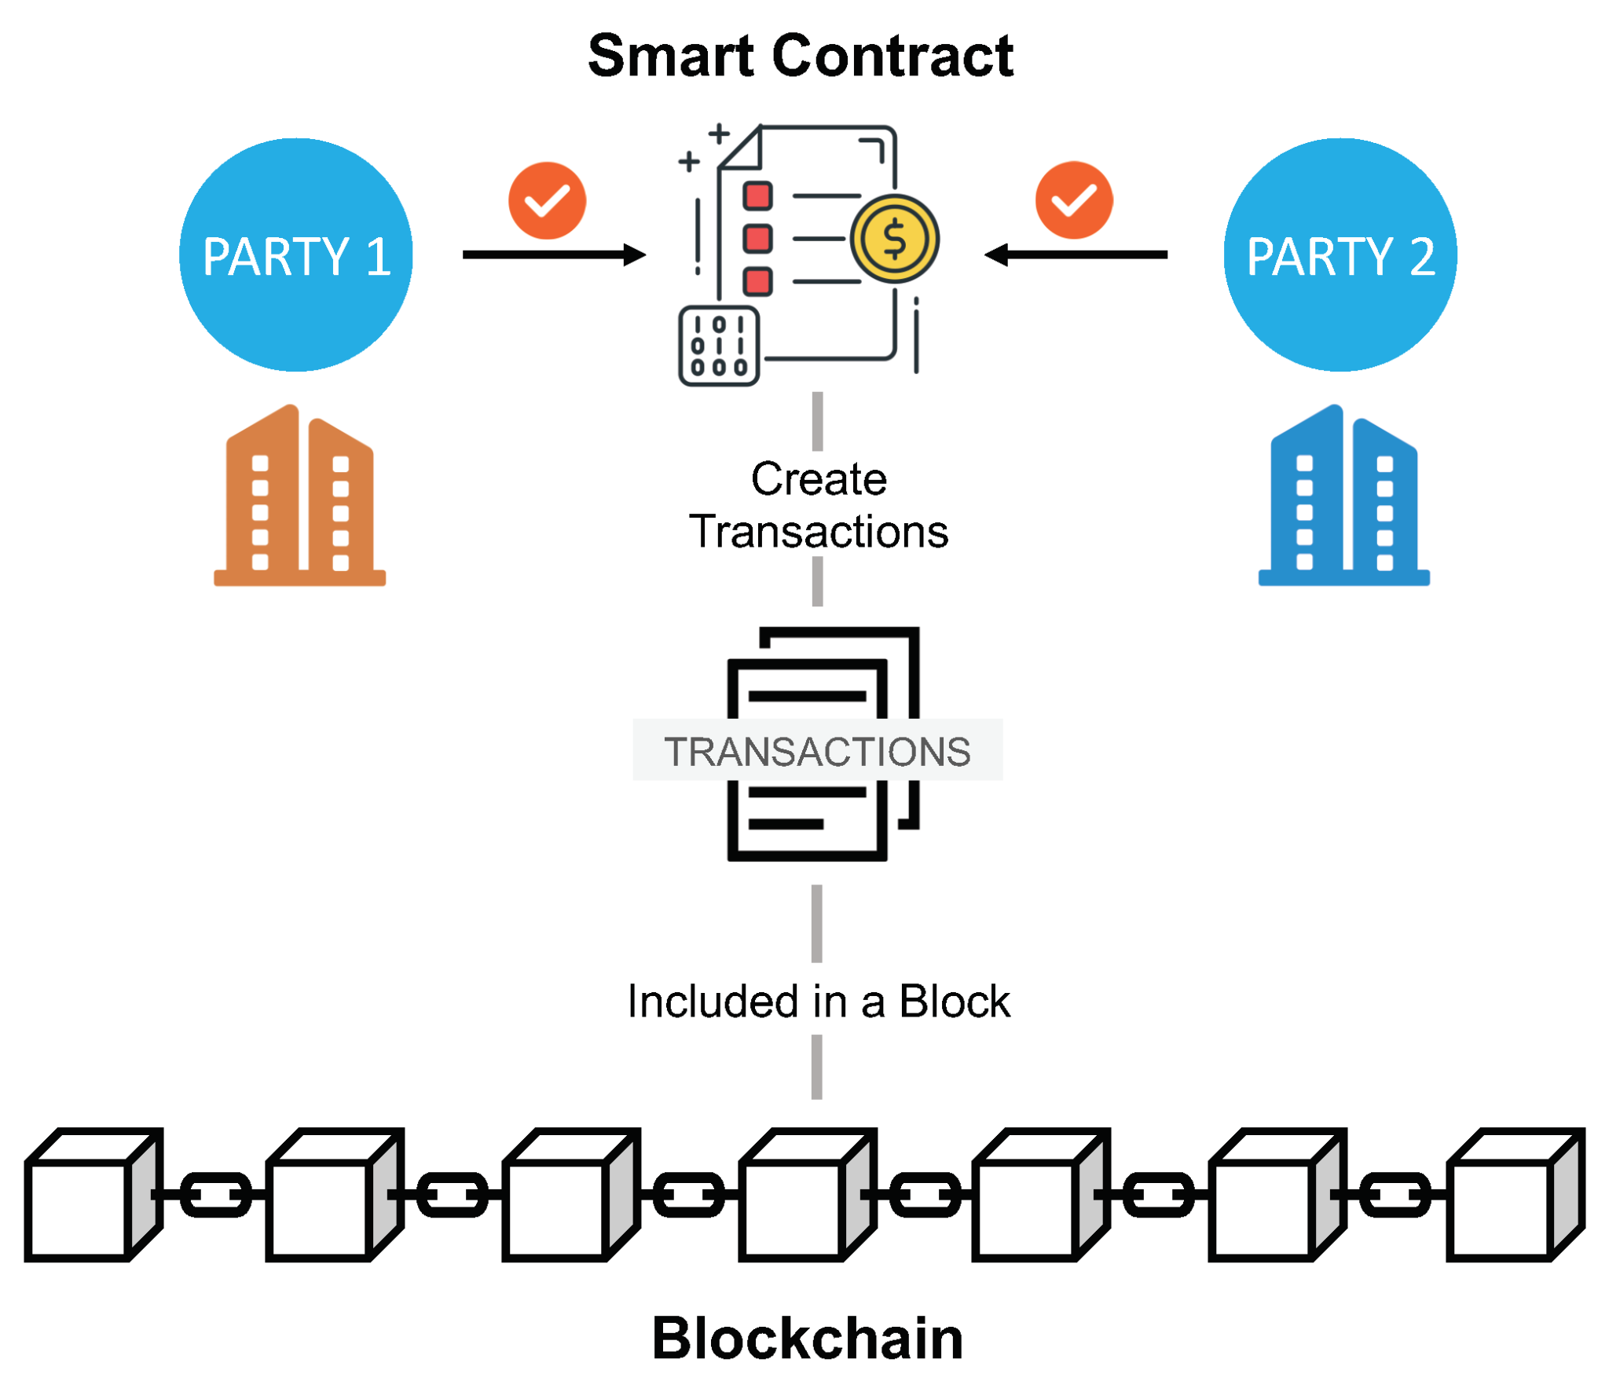
How Does It work
The Shipping party creates a smart contract with information about the package.
Once the smart contract is deployed,both parties are able to interact with the smart contract through a QR code that links the web browser to the smart contract.

Slide 4
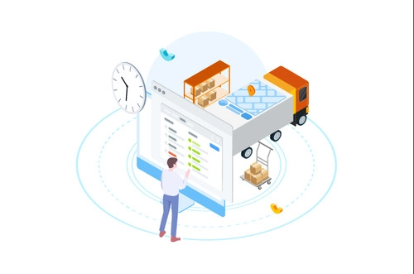
More on how it works
The shipper fills in a form with details on the package being shipped.
The information is stored on the smart contract
This helps make the connection between the smart contract and the front end UI seamless.

Slide 5
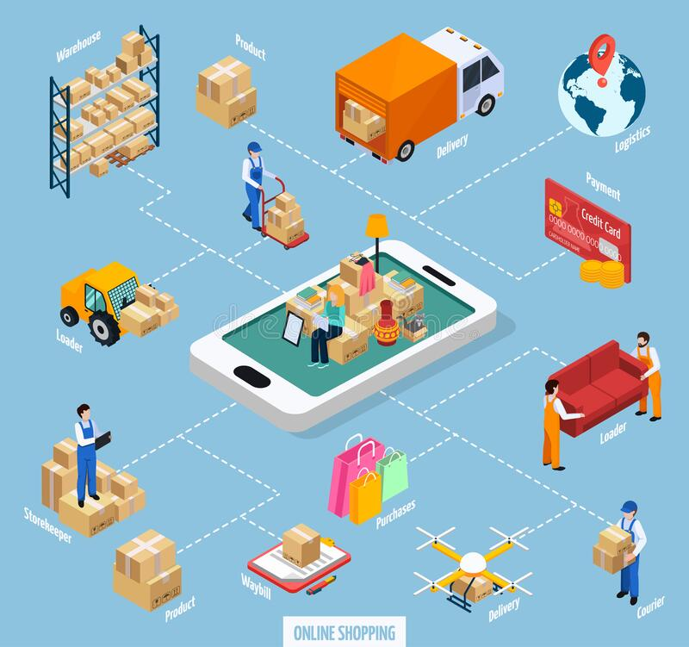
More on how it works
This means, the shipper has clear real time decentralized view of the package movement as long as the smart contract is updated .
This also presents potential problems as much as it helps create a decentralized visual of package movement.

Slide 6
Tech Stack
MetaMask
React
Solidity
Web3

Slide 7
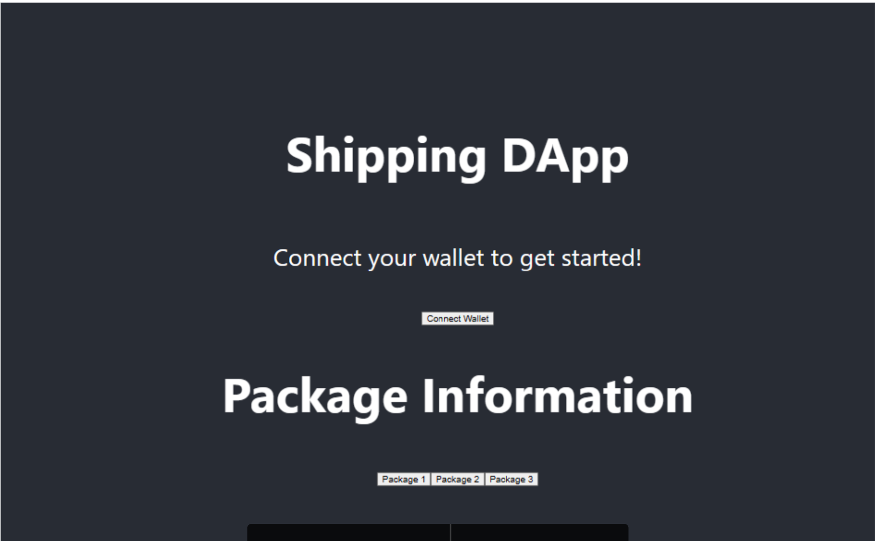
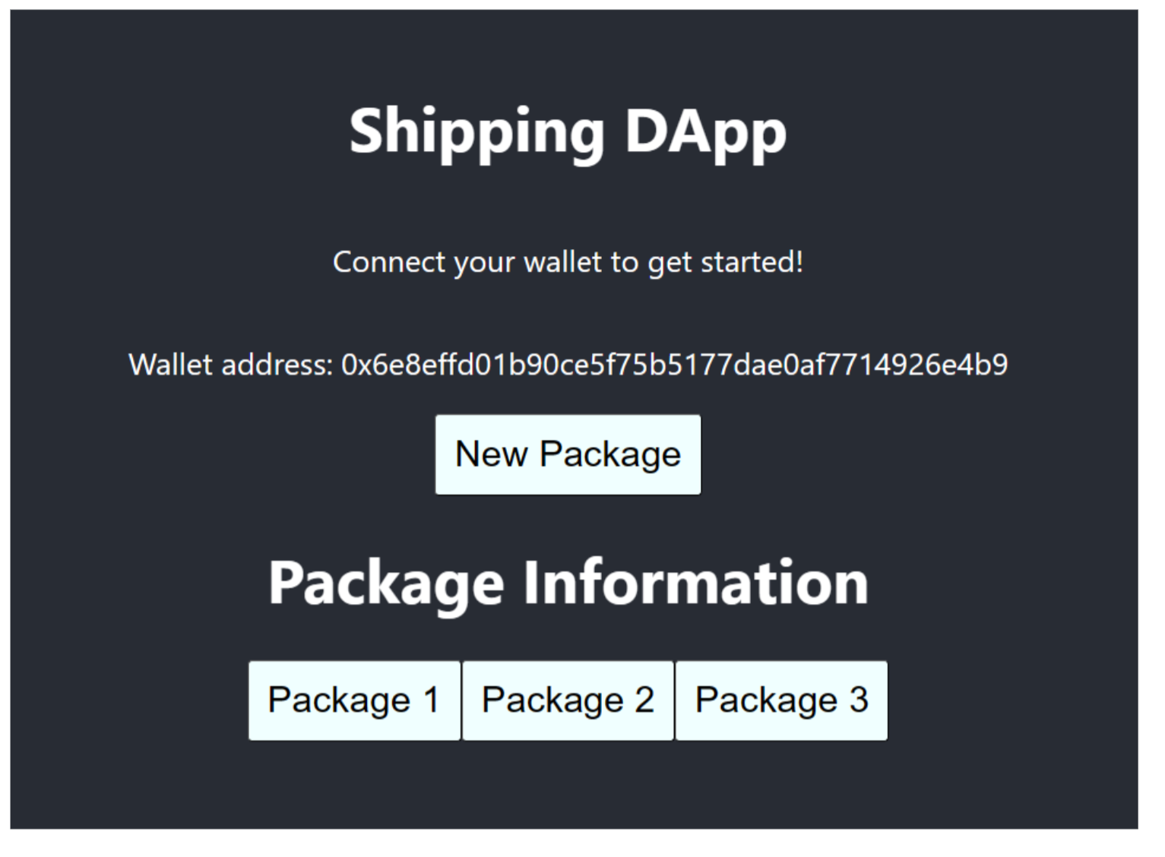
UI Layout

Slide 8
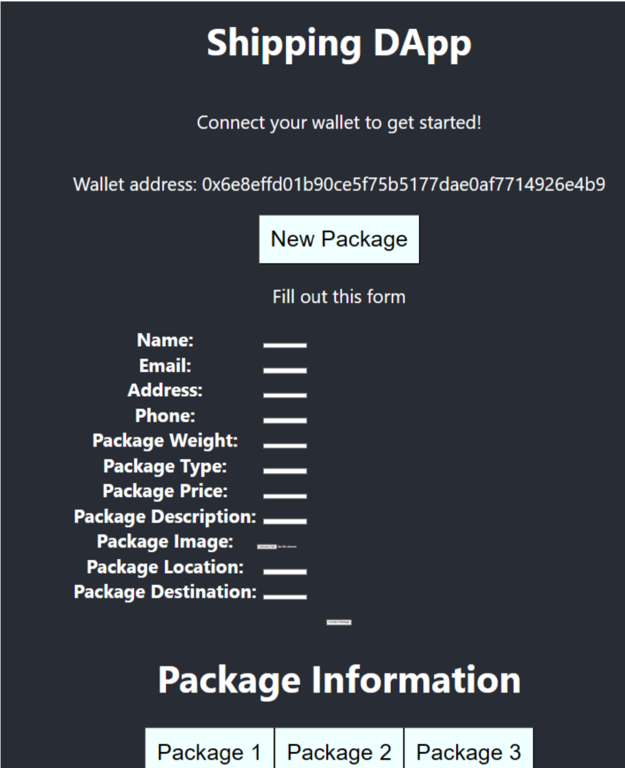
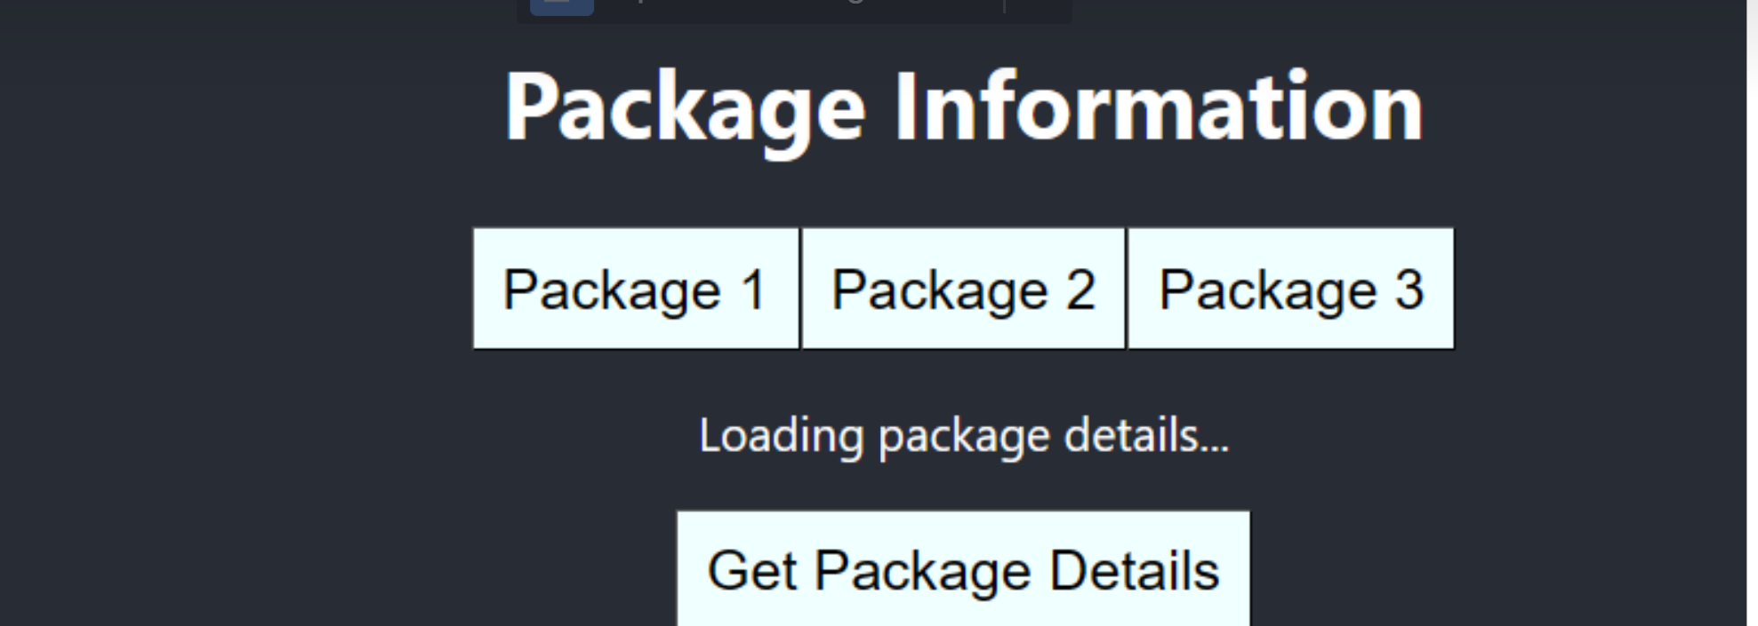
Cont.

Slide 9
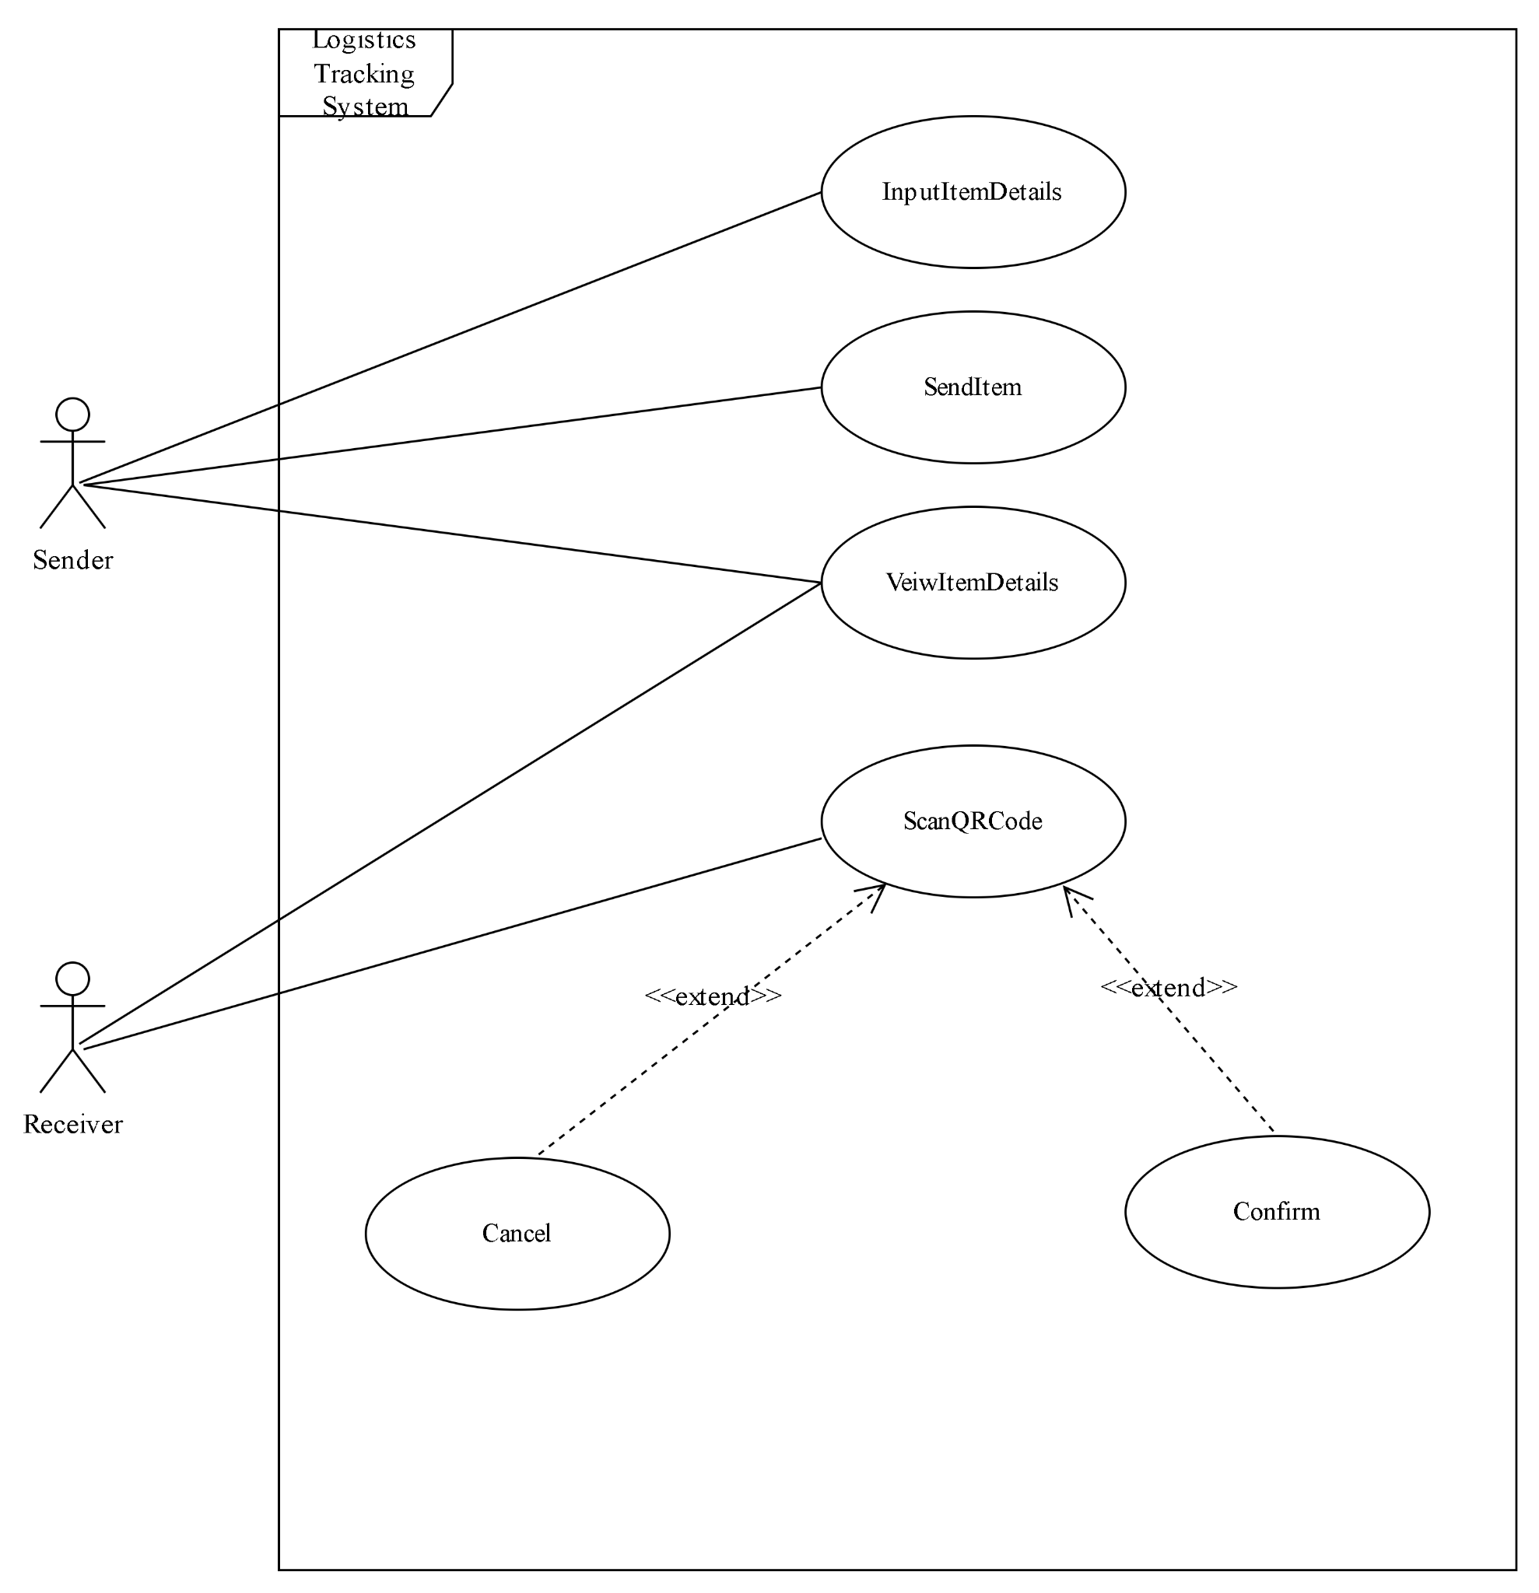
Use Case Diagram.

Slide 10
Challenges
Issues with learning React and it’s components
Properly learning how to use Git
Having to change large portions of code

